Slide 1

PROGRESS
Project Documentation:
Code of conduct
Requirements Specifications
Project Monitoring
Notes:
What we have done for the moment

Slide 2
PROGRESS
Data Collection
Data Preparation
Classification of the Suburbs with the help of the data
Recommendation system with few selection Criteria
Notes:
What we have done for the moment

Slide 3
PROGRESS
Website design:
Design the Logo
Prototype of few pages using Figma
Notes:
What we have done for the moment

Slide 4
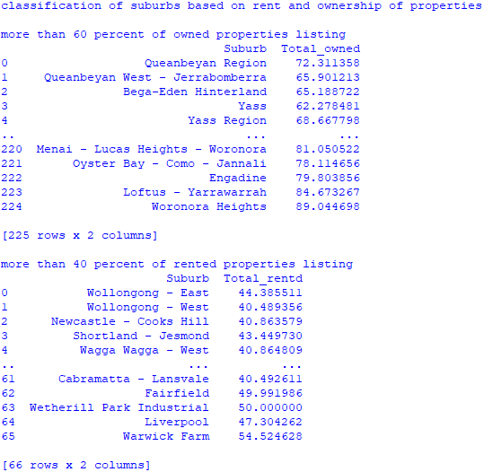
Suburb Classification
Suburb Classification Based on Rent and Ownership of properties
More than 60% of owned properties
More than 40% of Rented properties

Slide 5
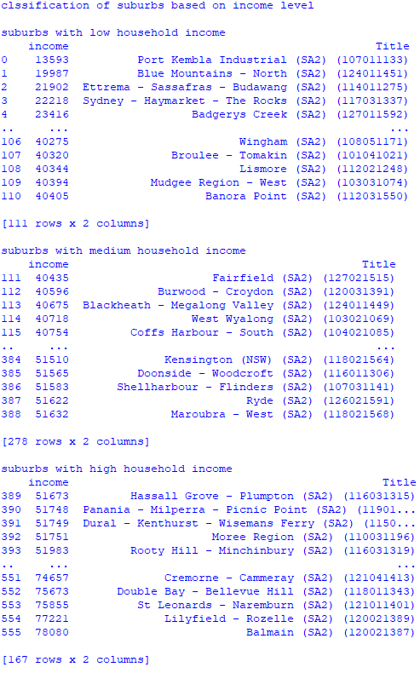
Suburb Classification
Suburb Classification Based on Income levels
Greater than 30% of the income levels as Highest Income Level
Less than 20% of the income levels as lowest income
ranges
And the income ranges in between as Medium

Slide 6
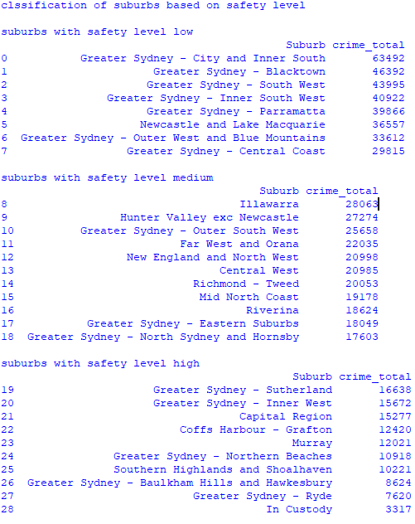
Suburb Classification
Suburb Classification Based on Safety Levels
Least 30% being highly Safe
Least 20% being a bit Dangerous
And the crime rates ranges in between as Medium

Slide 7
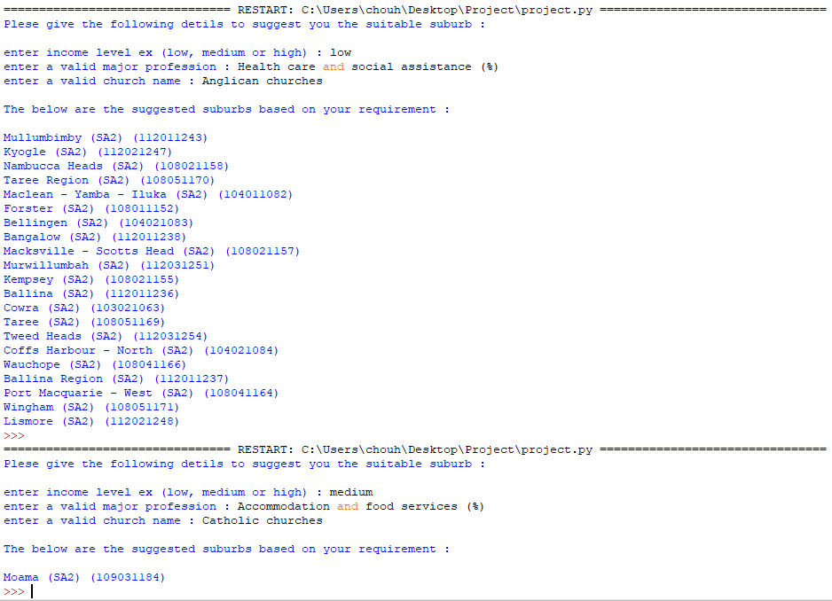
Sample Recommendation System
Recommendation of suburbs based on some criteria
Income Levels
Major Professions in the suburbs
Type of preferred Churches in the suburb

Slide 8
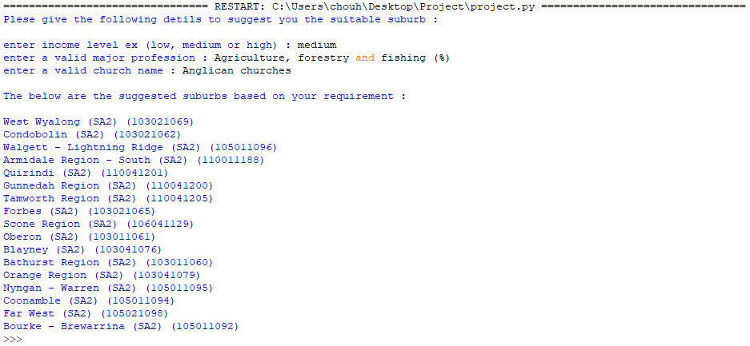
Sample Recommendation System
Another Sample of Results
Income Levels
Major Professions in the suburbs
Type of preferred Churches in the suburb

Slide 9
PROBLEMS
Challenges faced to do the requirement analysis
Difficulty to find the most relevant data for data preparation
Data Wrangling - Missing Data
Inconsistency of data among different files.
Notes:
What we’ll do next

Slide 10
INCOMPLETE TASKS
Back-end
Property listing in all the suburbs.
Robotic program for Commute distance calculation.
Full pledged Recommendation System.
Front-end
Actual Development based on prototype.
Integration with Backend
Testing of the application

